Slide 1
Summary of Hue Testing Results in Kingdom
IHS Global, Inc.

Slide 2
Outline
Part 1. Feasibility Study of Hue Dynamic Workflow
Part 2. Performance Tests
Data Generating
Data Displaying
Part 3. Accuracy Tests
Part 4. Some Visual Examples

Slide 3
Part 1. Feasibility Study of Hue Dynamic Workflow

Slide 4
Dynamic Workflow Design Factors
Performance
Hardware and Software Environment
Algorithmic Considerations

Slide 5
Spectrum of Software Responsiveness
Real Time
Pseudo-real time
Progressive
Non-interactive
Instantaneous
Uninterrupted train of thoughts
Stay-focused
Task-switching
0.1 s
1s
10s
>10s
The guidelines for software responsiveness has not been changed in recent two decades [Miller 1968; Card et al. 1991].
Notes:
http://www.nngroup.com/articles/response-times-3-important-limits/
The basic advice regarding response times has been about the same for thirty years [Miller 1968; Card et al. 1991]:
0.1 second is about the limit for having the user feel that the system is reacting instantaneously, meaning that no special feedback is necessary except to display the result.
1.0 second is about the limit for the user's flow of thought to stay uninterrupted, even though the user will notice the delay. Normally, no special feedback is necessary during delays of more than 0.1 but less than 1.0 second, but the user does lose the feeling of operating directly on the data.
10 seconds is about the limit for keeping the user's attention focused on the dialogue. For longer delays, users will want to perform other tasks while waiting for the computer to finish, so they should be given feedback indicating when the computer expects to be done. Feedback during the delay is especially important if the response time is likely to be highly variable, since users will then not know what to expect.

Slide 6
Testing Environment
High-end GPU
nVidia Geforce GTX Titan with 6G memory
HP Workstation Z800
Memory: 64G
CPU:
Intel Xeon CPU X5570 @ 2.93 GHz
2 processors or 8 cores

Slide 7
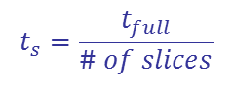
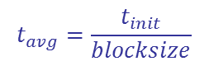
Factor I. Performance
Load Amp
Symmetry: average time per slice
Convert Amp to Hue format, apply mistie filter*
$$t_{s}=\frac{t_{full}}{\# of slices}$$
t_{s}
Generate Symmetry
I3D: Initial slice display time (block-slice time)
$$t_{init}=t_{s}×(blocksize+overlap)+t_{i3D}$$
Generate I3D
t_{i3D}
I3D: average slice display time
Render in VuPAK*
$$t_{avg}=\frac{t_{init}}{blocksize}$$
Note: * time is not estimated in these steps.

Slide 8

Symmetry – Time Slice
window size: 5x5x21
$$t_{s}=\frac{t_{full}}{\# of slices}$$
10 samples above
10 samples below
Output: Symmetry Slice
Input: Symmetry slices

Slide 9
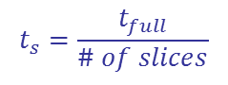
Symmetry – Vertical Slice
window size: 5x5x21
$$t_{s}=\frac{t_{full}}{\# of slices}$$
Post 2 slices
Previous 2 slices
Input: Symmetry slices
Output: Symmetry Slice

Slide 10
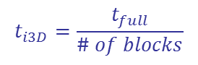
I3D Must Be Processed in 3D
Block size: 64x64x64 (size is defined for 3D FFT)
Overlap: 40
Applied for time slice, VSD inline and xlines
$$t_{i3D}=\frac{t_{full}}{\# of blocks}$$
Overlap: 20
Brick size: 64
Overlap 20
Brick size: 64
Input: Symmetry slices
Output: I3D (64 slices)
Notes:
Lower limit
The bigger block size, the better results, the heavier computation

Slide 11
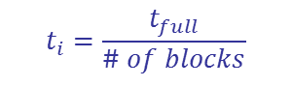
I3D Time Estimation
Total computation time for I3D (directly input from amplitude)
tinit=(64+20*2)*t_{s}+t_{i}~=100t_{s}+t_{i}
where: t_{i} – time need to generate 3D from
symmetry for one time slice
t_{s}- symmetry time (slice)
tinit – total computation time (slice)
$$t_{i}=\frac{t_{full}}{\# of blocks}$$

Slide 12
Performance Summary*
Attributes | Golden (25M) 145x145 x 1125 | Clam Lake (512M) 355 x 501 x 2000 | Swift (3.21G) 934 x 1166 x 2000
Symmetry (full volume) | 4s | 86 s | 635 s
Symmetry (z-slice) | 0.003 s | 0.043 s | 0.32 s
Symmetry (inline, xline) | 0.027 s | 0.24, 0.18 s | 0.68, 0.54 s
I3D (full volume) | 29s | 446 s | 6044 s
I3D Initial (z-slice) | 1.95 s | 18.57 s | 225.4 s
I3D Initial (inline, xline) | 15.5 s | 104.4, 74.9s | 482.2 (8 mins!), 385.7s
I3D average (z-slice) | 0.03 s | 0.292 s | 3.52 s
I3D average (inline, xline) | 0.24 s | 1.63, 1.25s | 7.53, 6.0s
Note *: Hue format conversion time and 3D rendering time are not included. Except the time for full volume generation, all other times are estimated based on the full volume time.
Green: instantaneously Blue: uninterrupted train of thoughts Red: stay-focused Black: task-switching

Slide 13
Degree of Responsiveness in Hue’s Demos
Responsiveness | Time Limit* | Hue’s Demos | Note
Real time Instantaneous | 0-0.1s | Inline, xline, z-slice browsing, 3D probe, RGB co-blending, opacity
Pseudo-real time Uninterrupted thoughts | 0.1-1s | Display large lines, spectrum decomposition, 1D/2D FFT
Progressive Stay-focused | 1-10s | Display large lines, spectrum decomposition, 1D/2D FFT | Continuous feedback
Non-interactive Task-switching | > 10s | Horizon auto-picking | Continuous feedbacks Save on HD
Ideally, seismic
attributes
interpretation

Slide 14
User Preference: on-the-fly vs. pre-calculated
User’s preference on “on-the-fly”
100%
Symmetry
I3D
Prefer “saved-volume”
Response time
0
0.1s
1s
10s
100s
Real Time
Pseudo-real time
Progressive
Non-interactive

Slide 15
Conversation with Hue*
Symmetry: go dynamic
I3D:
Cache on hard drive
Given the computation is so heavy, show results during computing the whole volume (“semi-dynamic” or continuous feedback mode)
Reduce the dynamic view size in VuPAK
“Parameter preview” mode
* Discussion with Marius and Bill at SEG on 9/25/2013 morning at Hue booth

Slide 16
Factor II. Hardware and Software Environment
Hardware
GPU requirement risks:
Single graphic card -> multiple graphic cards
Low-end graphic card -> high end graphic card
Software – Resource competition
3D visualization using memory and computational power of GPU
Time to render objects (additional time added to the formula).
Memory leak problem observed in VuPAK: volume render mode and data type co-blending. ← very critical, leave no resource for GPU computing at all!
Notes:
VuPAK cannot handle on-the-fly I3D

Slide 17
Factor III. Algorithmic Considerations
Global operators
The normalization step in Symmetry and I3D attributes.
Lack of global information to get the best brightness and contrast of full volume
May be overcome by running multi-passes.
Maximum Spanning Tree for automatic horizon and fault picking
Can be run dynamically, but not in parallel
Not quite suitable for GPU computing at this point

Slide 18
Discussions
Symmetry: can be dynamic
I3D: must be saved
Could be “semi-dynamic” (continuous feedback, regional preview)
Risk: need UI/workflow design works
Algorithmic Challenges - Global operators:
The normalization step in Symmetry and I3D attributes.
Minimum Spanning Tree for horizon and fault picking
User can turn on or off “dynamic” mode for both attributes

Slide 19
Part 2. Performance Tests

Slide 20
Part 2: Outline
Data Generating
Cache file generating and accessing
Workflow comparison
File compression ratio
Data Displaying
VSD

Slide 21
Testing Environment
Laptop DELL M4700
Core i7-3740QM CPU @ 2.70GHz (8 cores)
System memory: 32GB DDR3 @ 1600MHz
Quadro K1000M GPU – 192 CUDA cores
GPU memory: 2GB DDR3 @ 850MHz
Samsung SSD 500GB
Gigabit LAN connection

Slide 22
Cache File Generating and Accessing
Testing scenario
Generate Hue cache file on 4 dimensions (inline, cross line, time slice, brick)
Hue compression tolerance: 0 (uncompressed), 0.5, 1, 5, 25
Compare with inline reading speed of SDK on KSD 32bit and KSD 8bit
Compare with brick reading speed of SDK on Kingdom Brick (8bit)

Slide 23
Testing Datasets
Ghanarep (42GB, 105GB, 313GB)
TKS data formats: KSD 32, KSD 8, Brick 8
Hue data formats: Hue 0, 0.5, 1, 5, 25
Data type: amplitude, symmetry, I3D
Hue 0
KSD 8
Hue 0.5
SEGY file
.
.
.
Import SEGY
Hue compression
KSD 32
Hue 25
Brick 8
Generate brick

Slide 24
Amplitude Inline Reading
Hue 0.5 is 4-5 times faster than KSD 8 bit (Main use case)

Slide 25
Brick Reading
8 bit brick file is generated from the original KSD 32bit file
Hue 0.5 and Brick 8 are comparable
Green point indicates slower performance of Hue 0 vs. Brick 8

Slide 26
File Compression Ratio
Compression ratio = size(KSD 32) / size(Hue) on 4 dimensions
Hue uncompressed is 3.9 – 4.1 times larger than KSD 32
Note: KSD is only inline dimension and Hue is on 4 dimensions

Slide 27
TKS Workflow
Input: KSD 32bit (amplitude)
Output: KSD 8bit for Symmetry, I3D and Brick volumes
I3D tests done on 128X128X128 blocks with no overlap (Real I3D times will be 3-4 times slower)
Improved brick performance by writing bricks along with KSD instead of creating bricks after completion.
I3D Azimuth
Amplitude
(KSD 32)
Symmetry
I3D Dip
Amplitude
(Brick 8)
I3D Energy

Slide 28
Hue Workflow
Compression tolerance 0.5 on input and output 32bit data
Cached dimensions: Brick and Inline
Hue I3D result on 330 GB volume is estimated.
I3D tests done on 128x128x128 blocks with no overlap (Real I3D times will be 3-4 times slower)
Using TKS
Using HueViewer
I3D Azimuth
Using TKS
Amplitude
(KSD 32)
Amplitude
(Hue 0.5)
Symmetry
I3D Dip
(Brick and Inline)
I3D Energy

Slide 29
Testing Environment
HP Z400 Workstation
Xeon W3580 CPU @ 3.33GHz (6 cores)
System memory: 12GB DDR3 @ 1333MHz
GeForce GTX TITAN GPU – 2688 CUDA cores
GPU memory: 6GB GDDR5 @ 837MHz
Gigabit LAN connection

Slide 30
Symmetry Workflow Timing Results
44 GB
110 GB
330 GB
TKS vs. Hue
Hue computation includes uncompressing, computing and recompressing
If symmetry is repeated on Hue, only computation is required – no need to convert the input again
Time (minute)

Slide 31

Symmetry Data Size
44 GB
110 GB
330 GB
TKS vs. Hue
Size (GB)

Slide 32
I3D Hue Conversion
Hue computation creates 3 attributes (only bricks) in one file
We then extract each attribute into a separate file (Inlines and Bricks)
An enhancement to TKS to handle 3 attributes in one file can possibly avoid this additional work but this is non-trivial work.

Slide 33
I3D Workflow Timing Results
44 GB
110 GB
330 GB
TKS vs. Hue
Hue computation: includes uncompressing, computing and recompressing
Time (minute)

Slide 34
I3D Data Size
44 GB
110 GB
330 GB
TKS vs. Hue
330 GB size is extrapolated from the 5% completed volume.
Size sometimes varied because of a bug in Hue’s latest upgrade to performance – Across 3 runs, we got 3 results varying by almost 10% - the median is shown here.
Size (GB)

Slide 35
End-to-end Workflow Timing Results
44 GB
110 GB
330 GB
TKS vs. Hue
End to End = Amplitudes to I3D (bricks and Inlines) with intermediate symmetry (bricks and Inlines)
Time (minute)

Slide 36
End-to-end Workflow Data Size
44 GB
110 GB
330 GB
TKS vs. Hue
Total size = all 3 attributes of I3D in bricks and Inlines + Symmetry bricks and Inline
Time (minute)

Slide 37
Data Displaying on VSD
Dataset: Ghanarep 44GB
Data formats: KSD 32, KSD 8, Hue 0, 0.5, 1, 5, 25
Displaying inline/cross line/time slice (over network)
Two timing metrics:
Navigating time: time to navigate between inlines/cross lines (not applicable to time slice)
First time display: delaying time when a line/slice is first displayed. Larger than navigating time since TKS prefetchs several nearby lines.
Presented results are the average of 20 trials

Slide 38
Displaying Inline
Hue is slower than KSD in displaying an inline (can be improved with code optimizing)
Green points indicate inferior performance to KSD 32
Error bars indicate the standard deviation of 20 trials

Slide 39
Displaying Cross Line
Hue is faster than KSD (except Hue 0)
Green points indicate inferior performance to KSD 32
Error bars indicate the standard deviation of 20 trials

Slide 40
Displaying Time Slice
Hue is faster than KSD 32, but slower than KSD 8

Slide 41
Known Issues
Hue crashes on the 330 GB volume (potentially a bug in I3D code)
Hue data size depends on input data
Memory leak issue in VuPAK
Multi-threading issue with VDSImport plugin (if not fixed in TKS, Hue cache generation time will be 3-4 times slower)
> 120 story points for Hue stories (About 6-7 iterations assuming 2 hue developers working with us full-time)

Slide 42
Part 3. Accuracy Tests

Slide 43
Part 3: Outline
Peak Signal-to-Noise Ratio
Mean Absolute Error Ratio
Amplitude Absolute Error
Amplitude Spectrum
Data Distribution
Spectrum Decomposition
Wavelet Extraction

Slide 44
Accuracy Testing
Testing dataset
Salt Dome (554 MB)
Data format: KSD 32, KSD 8, Hue 0, 0.5, 1, 5, 25
Data type: Amplitude, Symmetry, I3D, spectrum decomposition
Testing scenarios
Data comparison: assessing quality of the compressed data on Amplitude, Symmetry, I3D data
Spectrum decomposition: assessing Hue compressing quality on different sub-band frequencies
Wavelet extraction

Slide 45
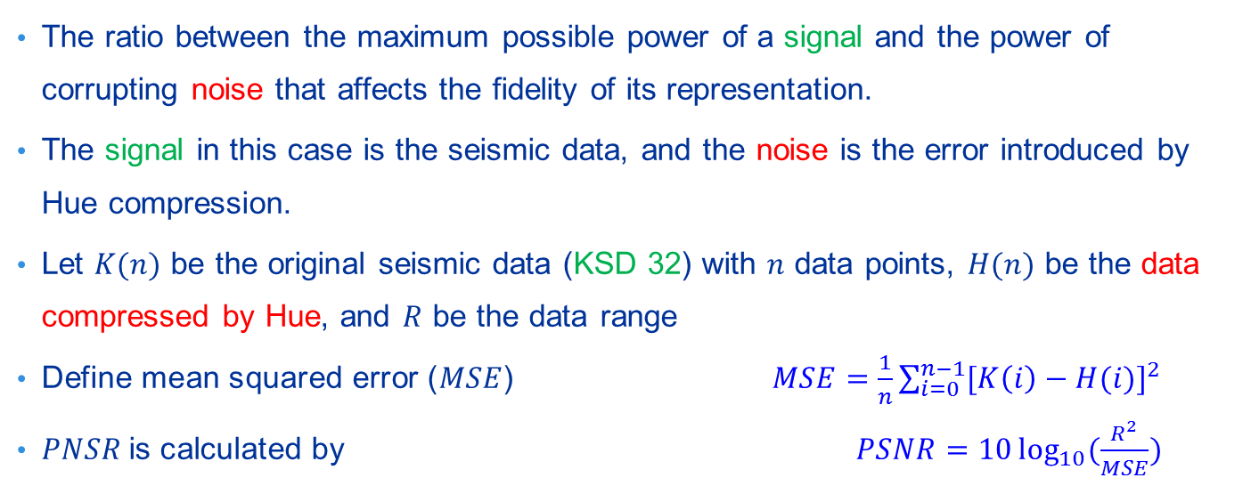
Peak Signal-to-Noise Ratio (PSNR)
The ratio between the maximum possible power of a signal and the power of corrupting noise that affects the fidelity of its representation.
The signal in this case is the seismic data, and the noise is the error introduced by Hue compression.
Let $K(n)$ be the original seismic data (KSD 32) with $n$ data points, $H(n)$ be the data compressed by Hue, and $R$ be the data range
Define mean squared error ($MSE$) $MSE=\frac{1}{n}\sum_{i=0}^{n−1}{{[K\left(i\right)−H(i)]}^{2}}$
$PNSR$is calculated by $PSNR=10\log_{10}{(\frac{R^{2}}{MSE})}$

Slide 46
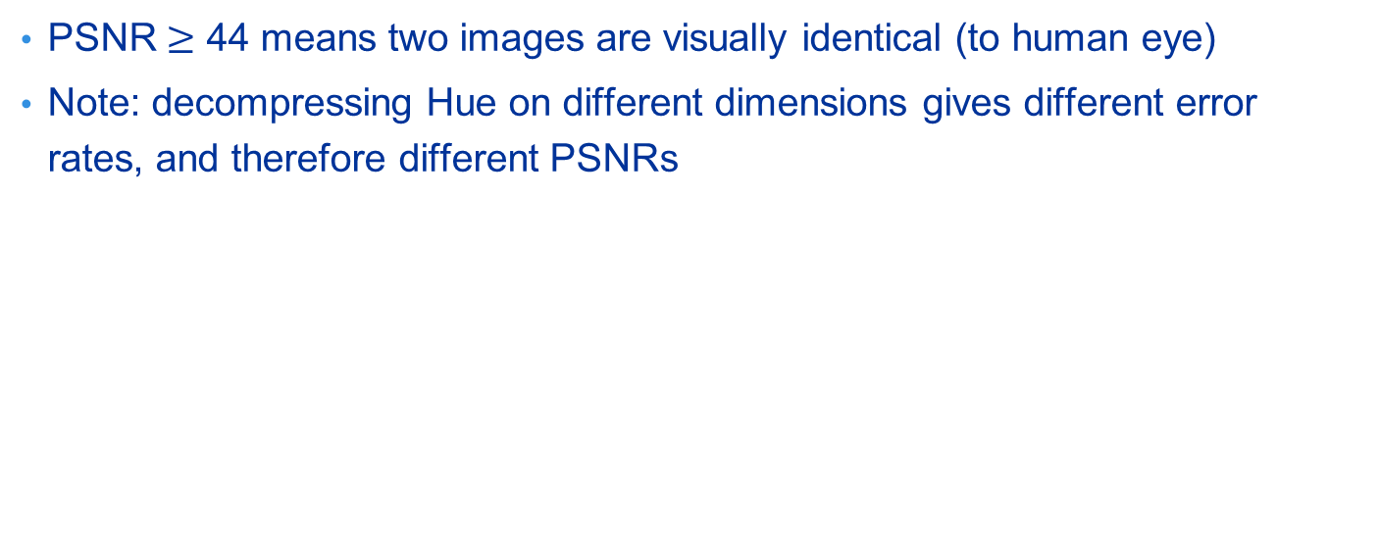
Peak Signal-to-Noise Ratio (PSNR)
PSNR $≥$ 44 means two images are visually identical (to human eye)
Note: decompressing Hue on different dimensions gives different error rates, and therefore different PSNRs
Higher is better

Slide 47
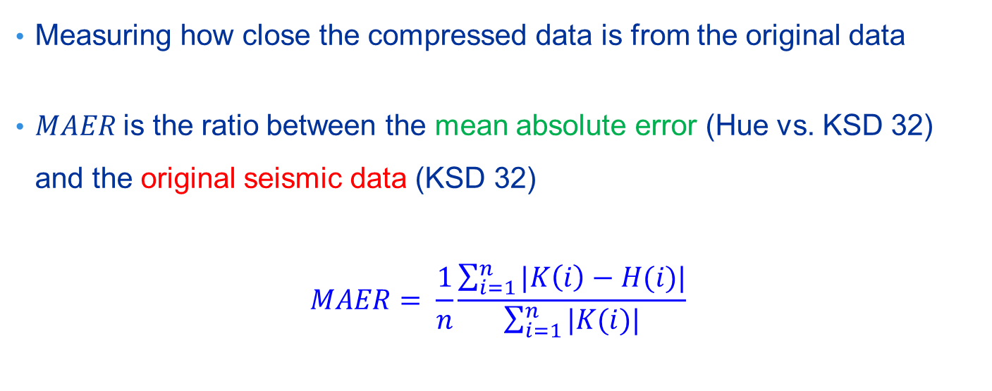
Mean Absolute Error Ratio (MAER)
Measuring how close the compressed data is from the original data
$MAER$is the ratio between the mean absolute error (Hue vs. KSD 32) and the original seismic data (KSD 32)
$$MAER= \frac{1}{n}\frac{\sum_{i=1}^{n}{|K\left(i\right)−H(i)|}}{\sum_{i=1}^{n}{|K(i)|}}$$

Slide 48
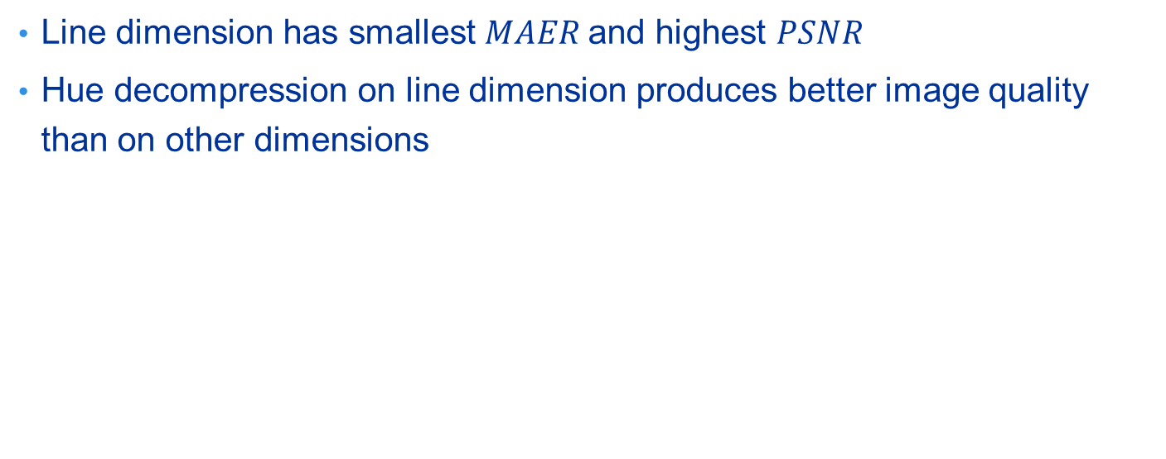
Mean Absolute Error Ratio (MAER)
Line dimension has smallest $MAER$and highest $PSNR$
Hue decompression on line dimension produces better image quality than on other dimensions
Lower is better

Slide 49
Amplitude Absolute Error
Calculate the absolute error between KSD 32bit and KSD 8bit/Hue
Comparing to KSD 32bit, only Hue 0.5 has lower amplitude error than TKS compressed KSD 8bit
Hue 0 (uncompressed) is perfectly identical to KSD 32bit
Lower is better

Slide 50
Amplitude Spectrum

Slide 51
Amplitude Data Distribution

Slide 52
Symmetry Data Distribution

Slide 53
I3D Data Distribution

Slide 54
Spectrum Decomposition
Decomposing the seismic data (KSD 32) into multiple sub-bands
Use Hue to compress the decomposed data and calculate the mean absolute error on each sub-bands
3. Compare
Sub-band 1 (KSD)
Sub-band 1 (Hue)
Sub-band 2 (KSD)
Sub-band 2 (Hue)
KSD 32
1. Spectrum decomposition
2. Hue compression
Sub-band n (KSD)
Sub-band n (Hue)

Slide 55
Sub-band Mean Absolute Error
Hue error increases at higher center frequencies

Slide 56
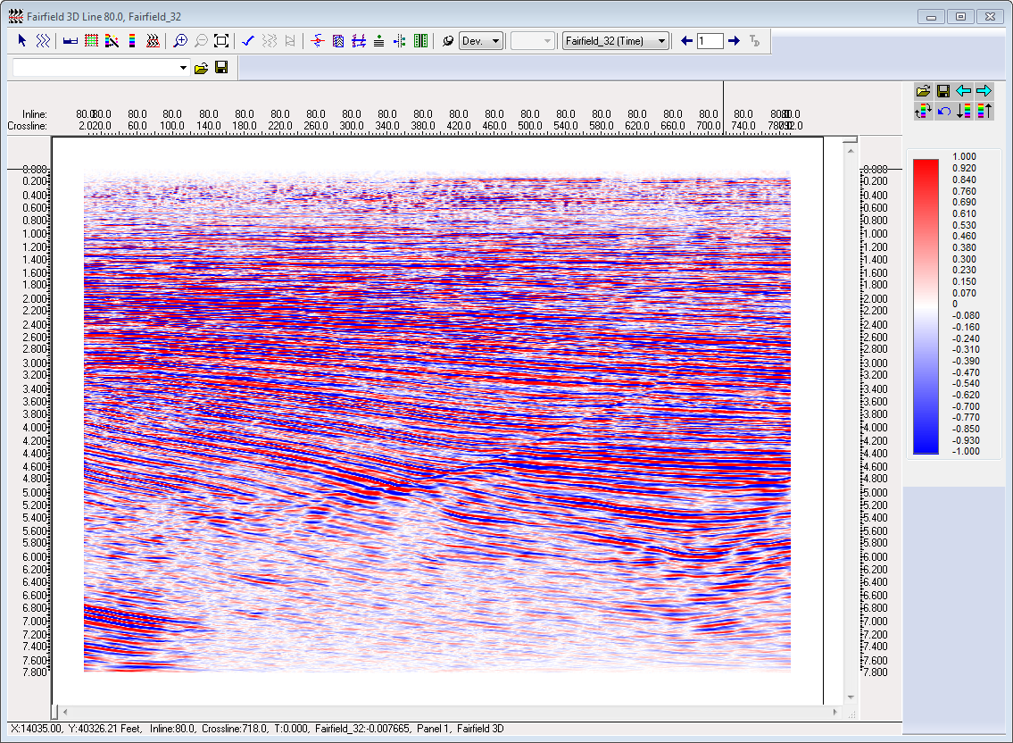
Wavelet Extraction
Extracting wavelets from Hue and compare to that of KSD
Wavelets are well-preserved even at high compression tolerances
Original seismic data
(Inline 80.0 from Salt Dome)

Slide 57
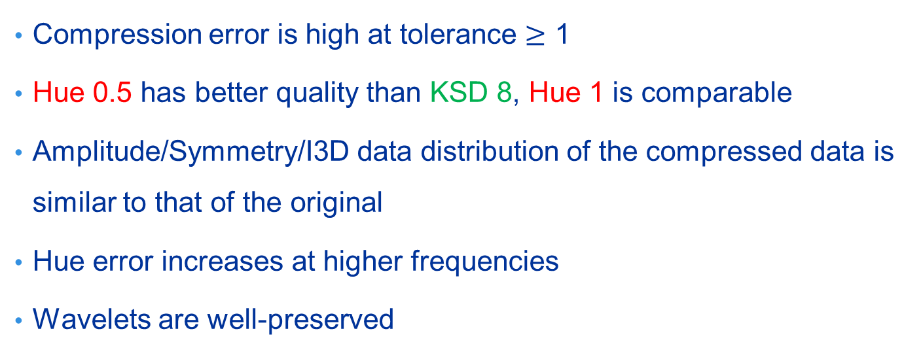
Remarks
Compression error is high at tolerance $≥$ 1
Hue 0.5 has better quality than KSD 8, Hue 1 is comparable
Amplitude/Symmetry/I3D data distribution of the compressed data is similar to that of the original
Hue error increases at higher frequencies
Wavelets are well-preserved

Slide 58
Part 4. Some Visual Examples

Slide 59
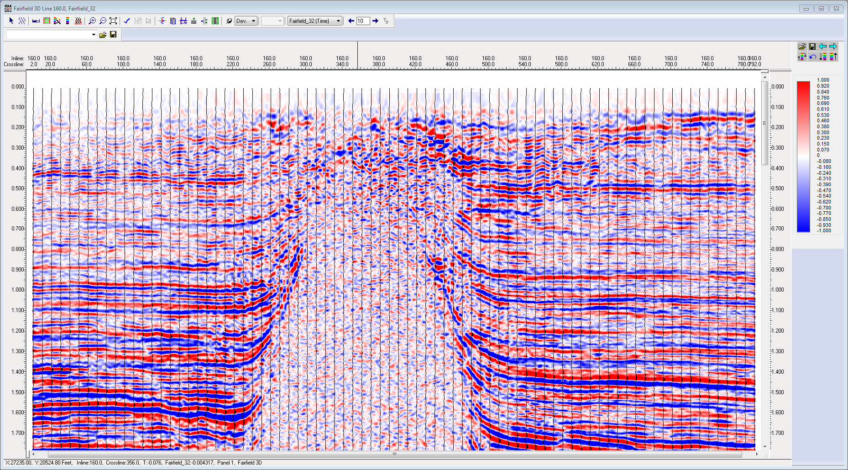
KSD 32 Amplitude Data (-7.96609 → 7.34643)

Slide 60
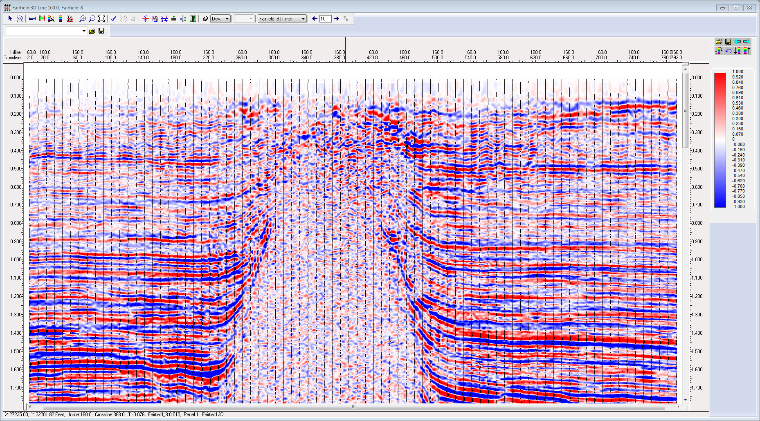
KSD 8 Amplitude Data (-7.92436 → 7.35890)

Slide 61

Hue 0.5 Amplitude Data (-7.97370 → 7.34148)

Slide 62

Hue 1 Amplitude Data (-7.97769 → 7.34424)

Slide 63
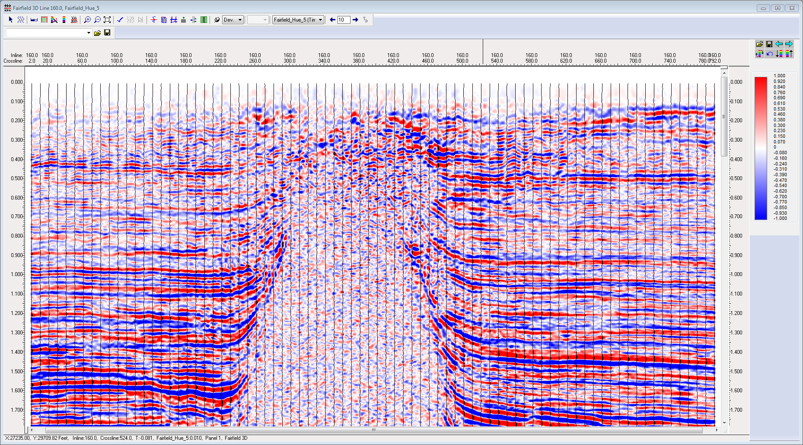
Hue 5 Amplitude Data (-7.97601 → 7.28190)

Slide 64
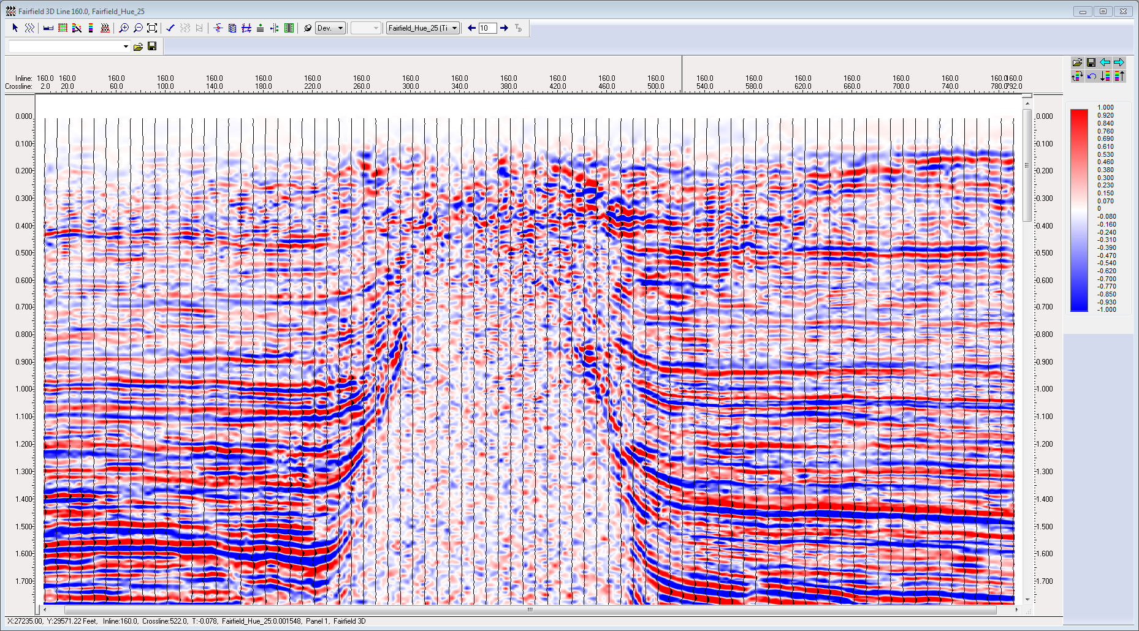
Hue 25 Amplitude Data (-7.88406 → 6.91142)

Slide 65
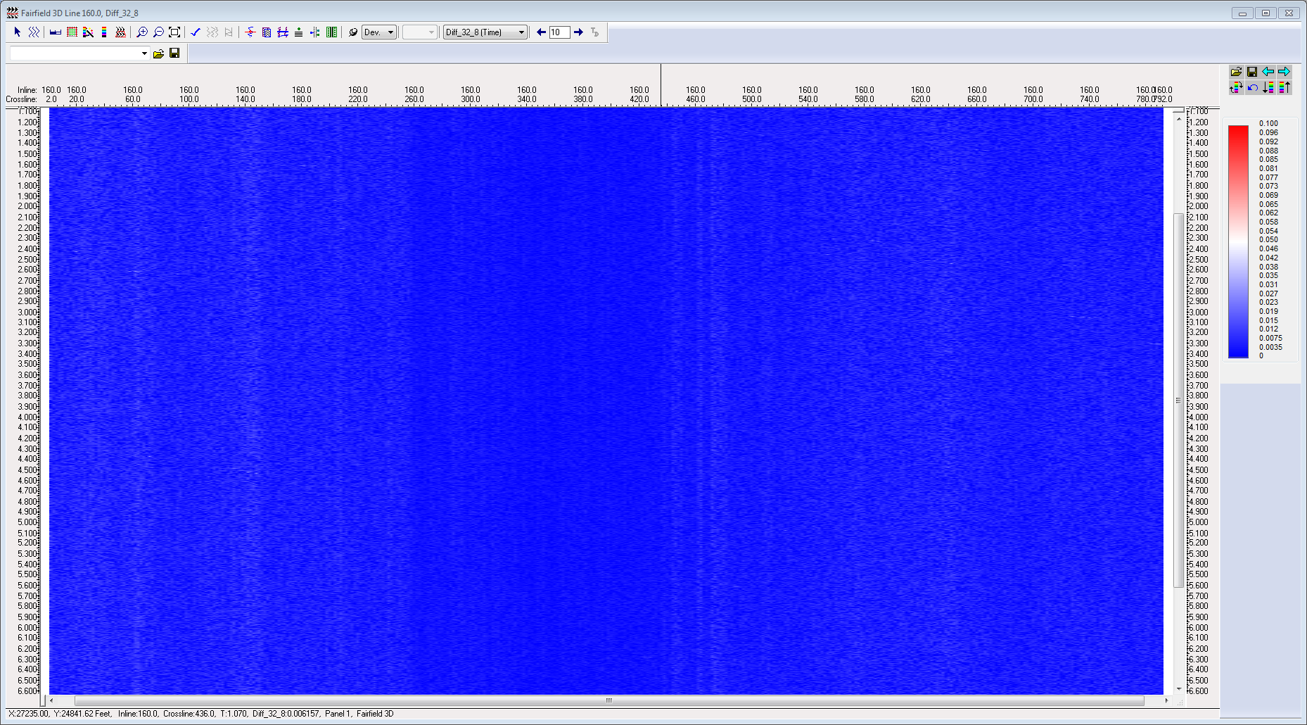
KSD 32 vs. KSD 8 (abs diff on line)

Slide 66
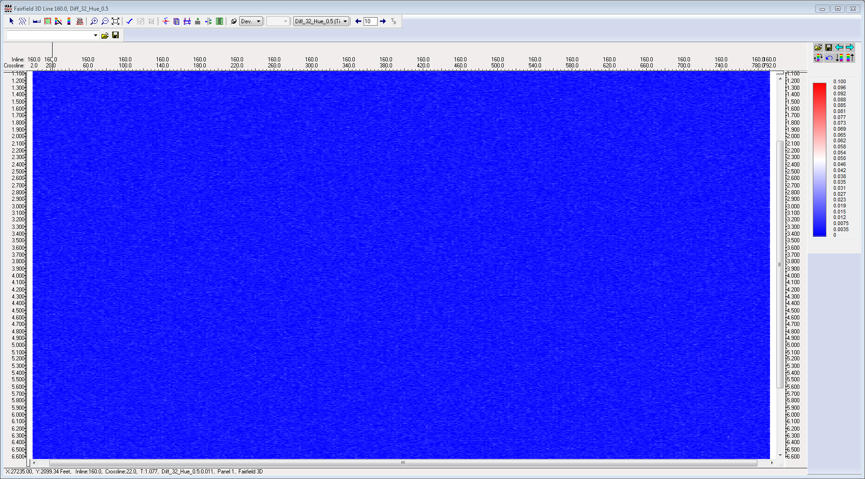
KSD 32 vs. Hue 0.5

Slide 67
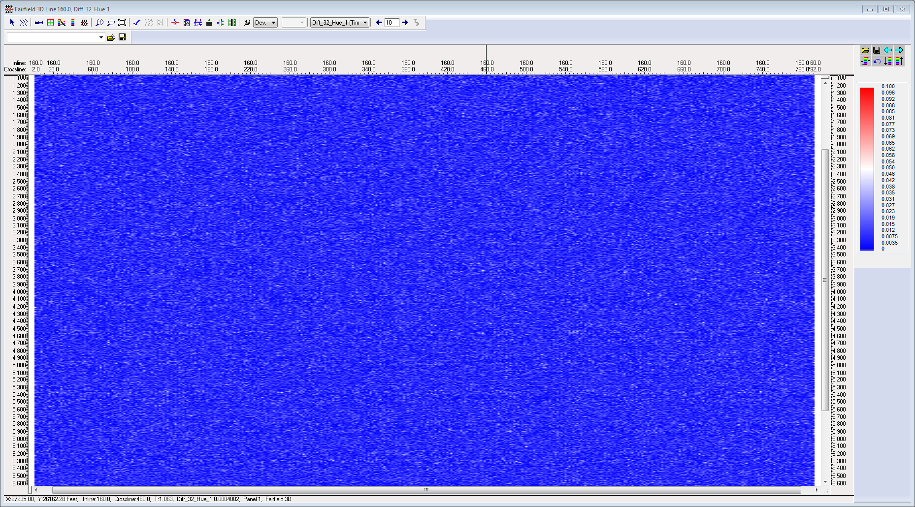
KSD 32 vs. Hue 1

Slide 68
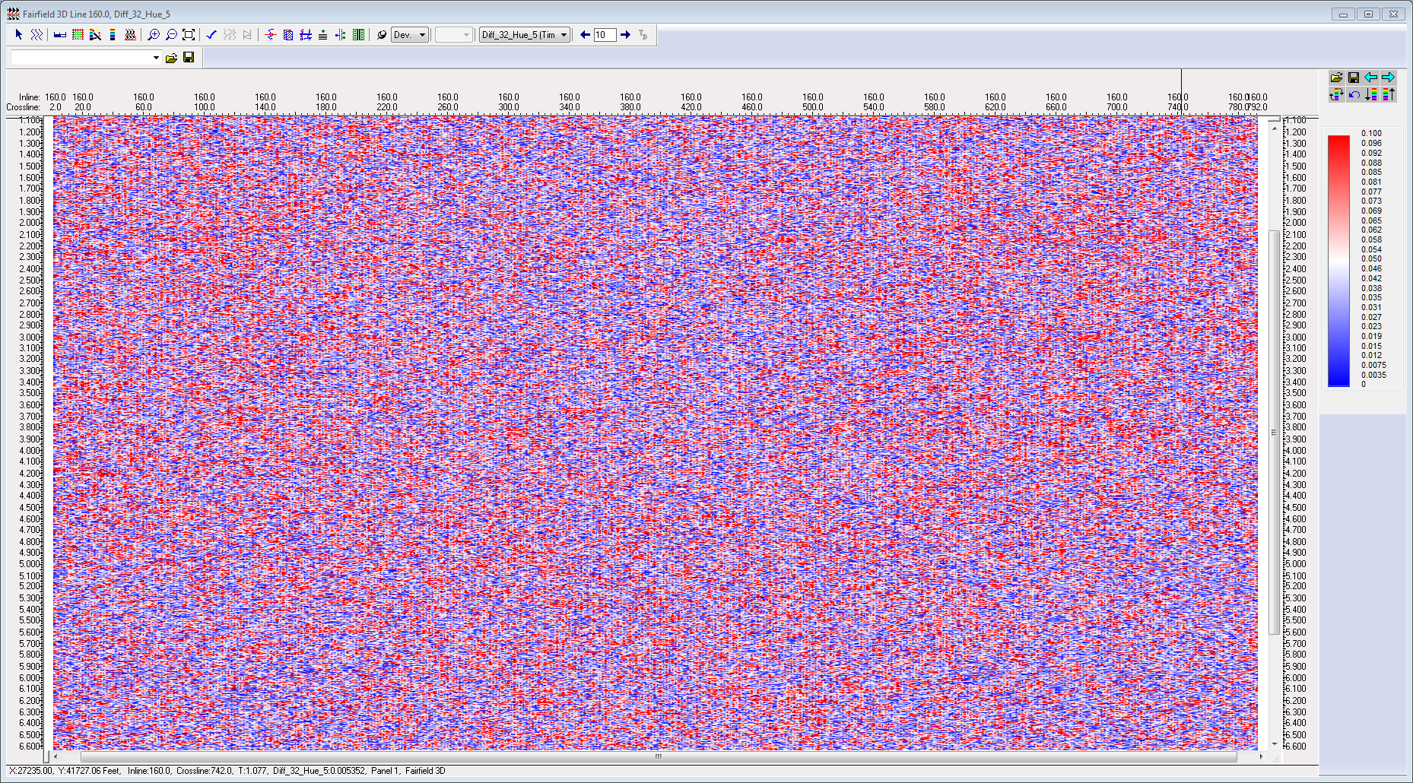
KSD 32 vs. Hue 5

Slide 69
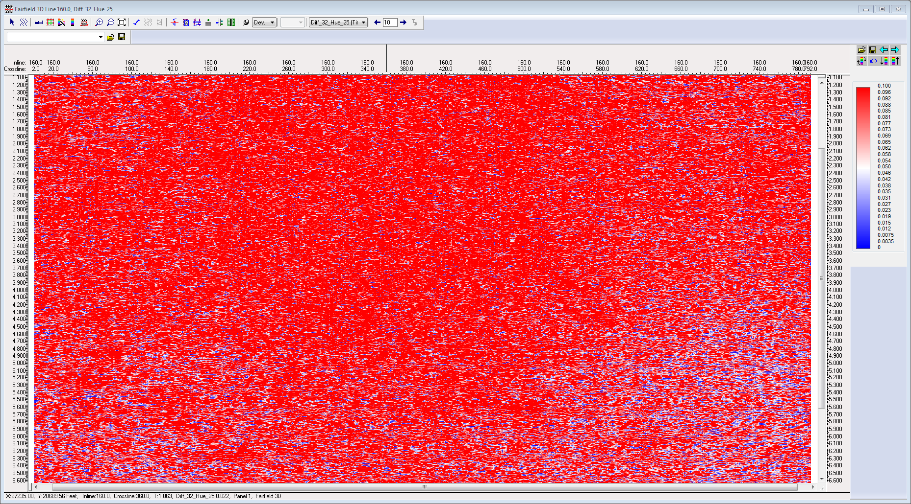
KSD 32 vs. Hue 25

Slide 70
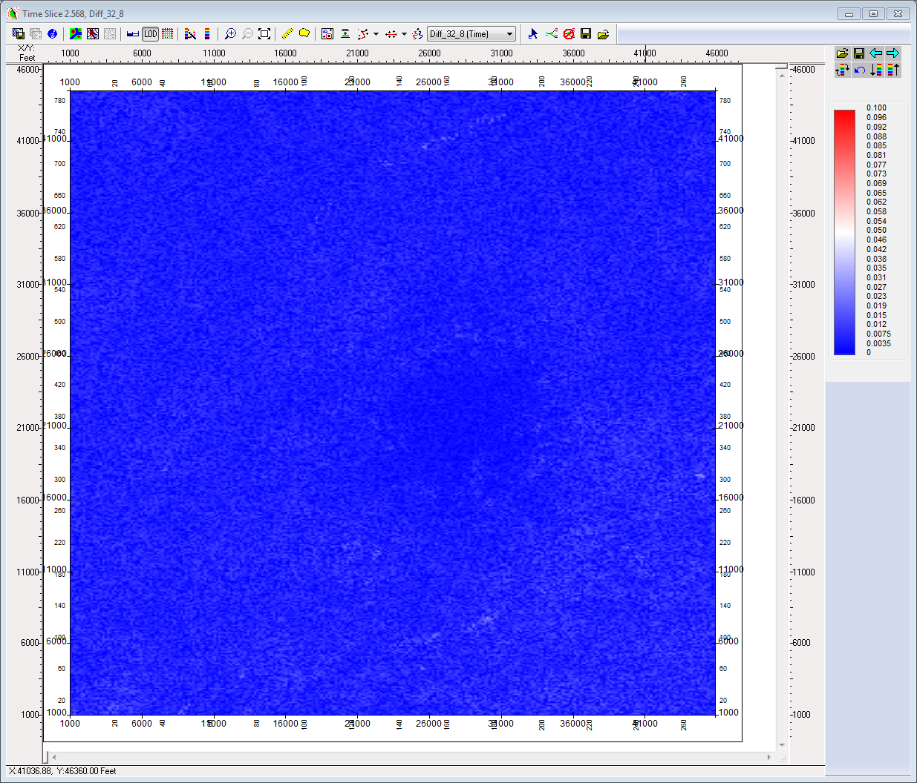
KSD 32 vs. KSD 8 (abs diff on time slice)

Slide 71
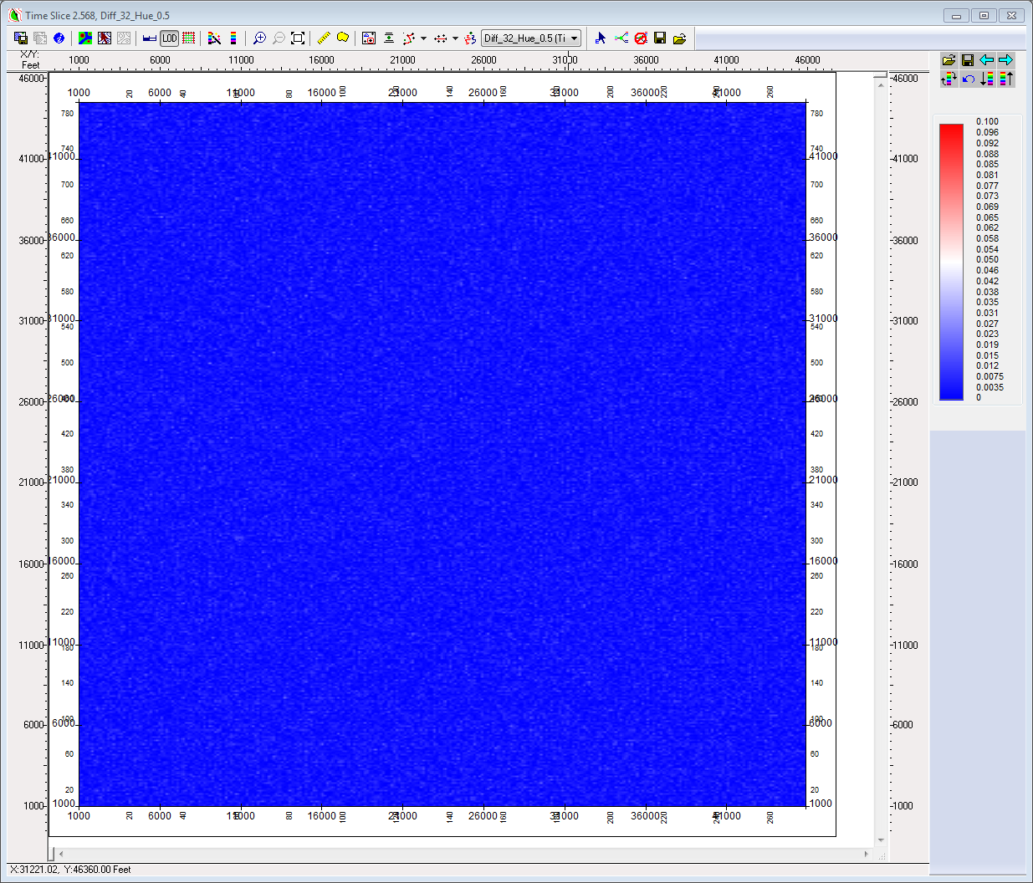
KSD 32 vs. Hue 0.5

Slide 72
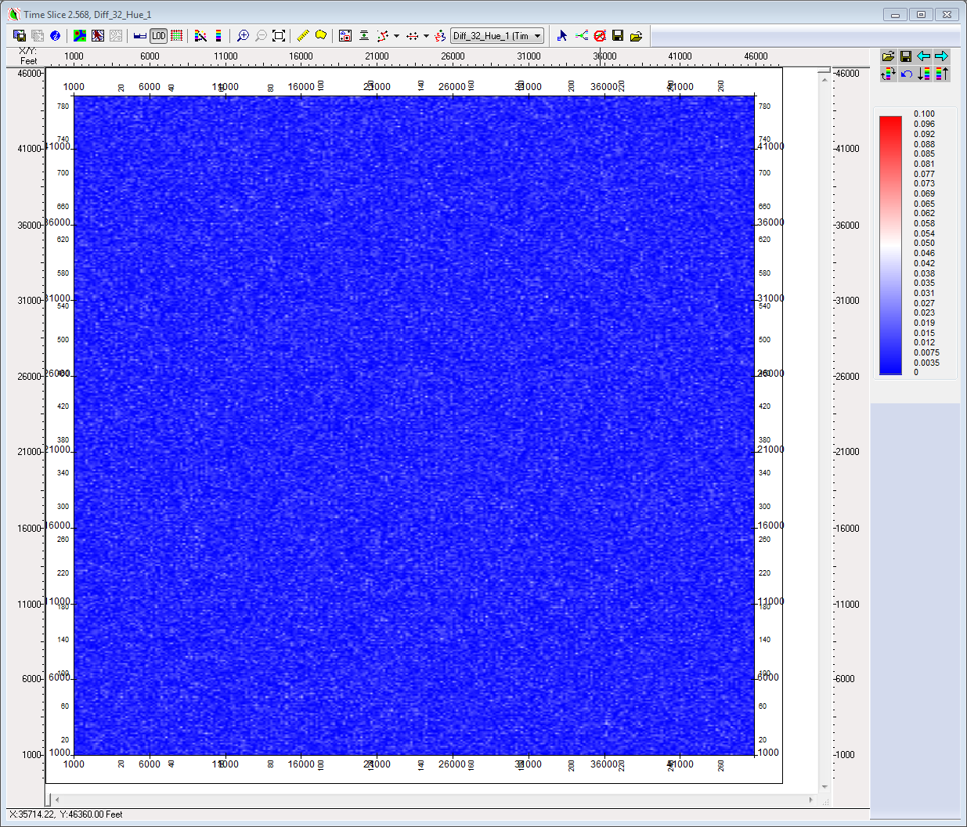
KSD 32 vs. Hue 1

Slide 73
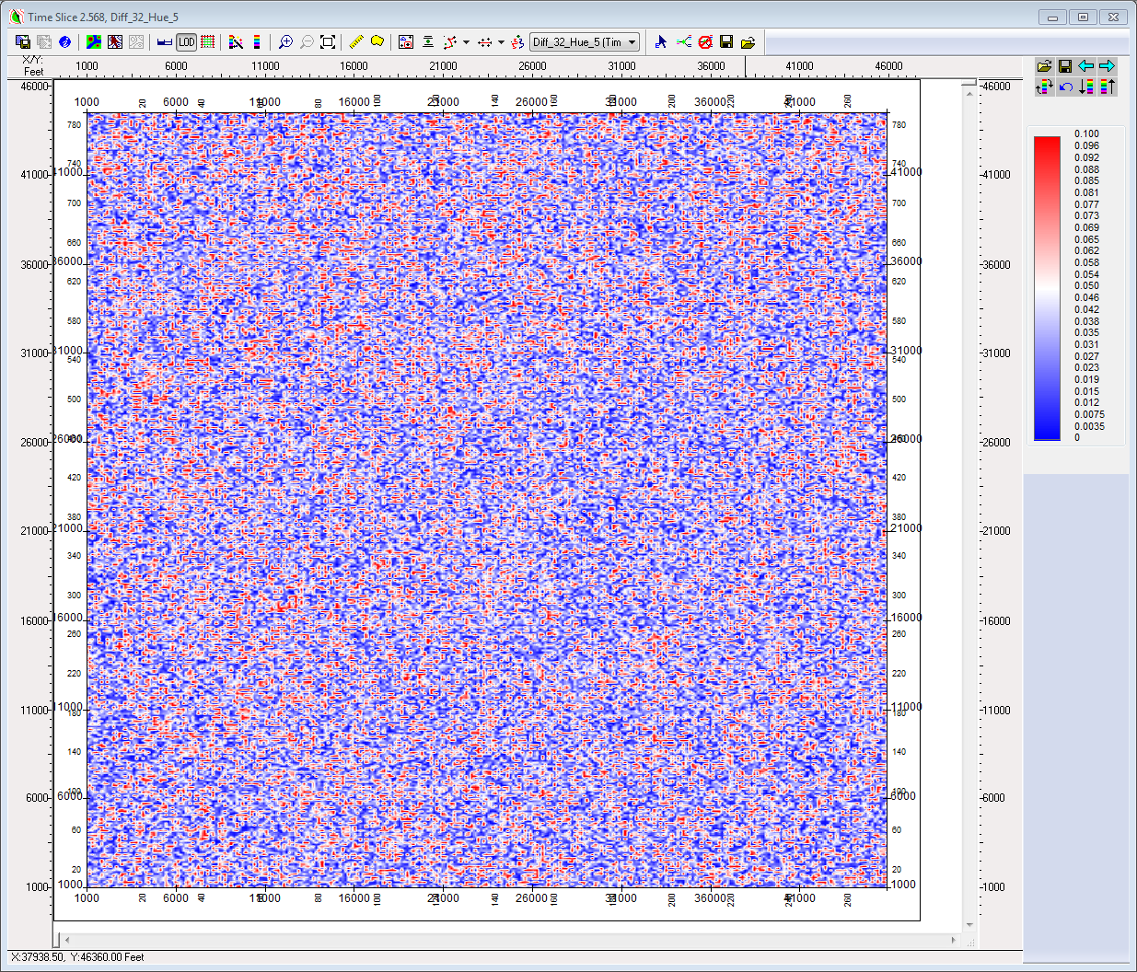
KSD 32 vs. Hue 5

Slide 74
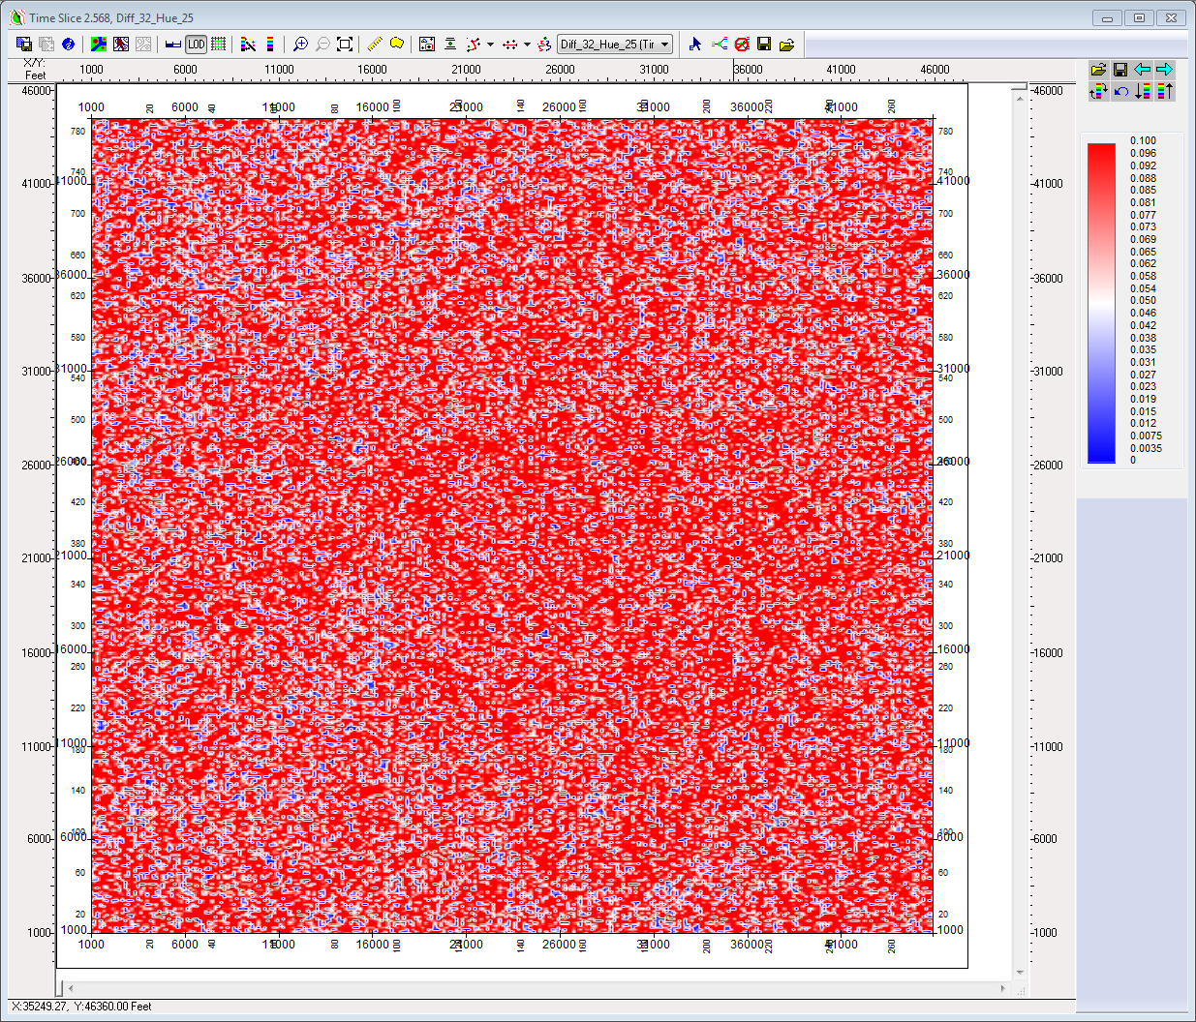
KSD 32 vs. Hue 25

